Slide 1

CLOTHING E-COMMERCE BUSINESS SITE
CHIC
Meera Al Zadjali 20202701
Buthaina Almawali 20201971
WWW.CHIC.COM

Slide 2
CONTENTS
INTRODUCTION
SCOPE OF THE PROJECT
SYSTEM ANALYSIS AND DESIGN
SYSTEM ANALYSIS
SYSTEM DESIGN
USER INTERFACE DESIGN
CODES
CONCLUSION
CHIC
Notes:
B: hello everyone my name is Buthaina and my college Meera, today we will be presenting to you our final presentation about a E-COMMERCE website project that we had created.
These are the contents of our project.

Slide 3
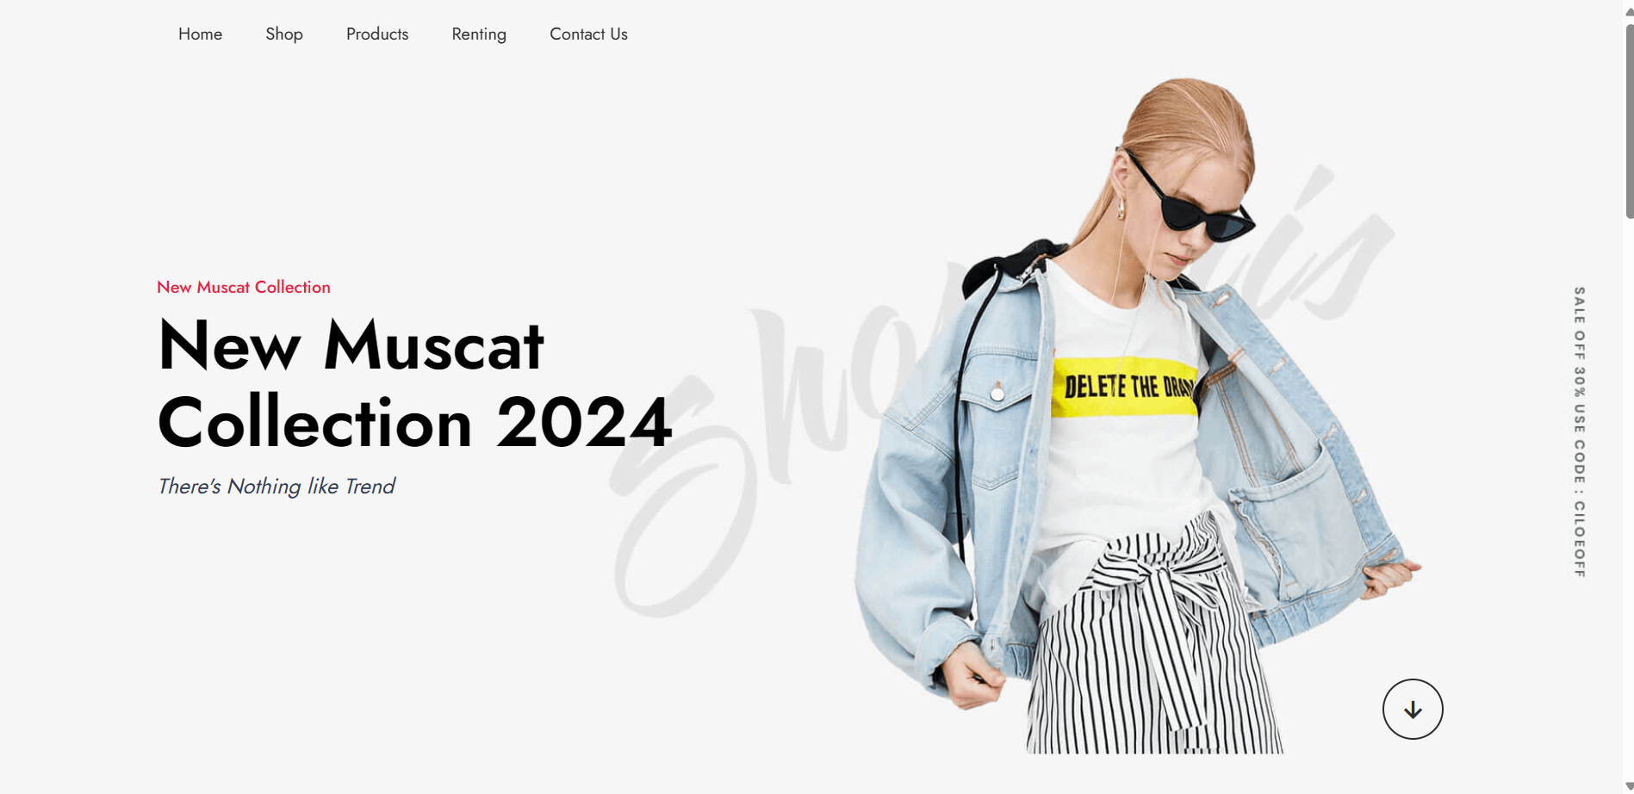
INTRODUCTION
Notes:
M: As an IT graduate, our final project presents CHIC, a user-centric e-commerce platform designed to revolutionize online shopping experiences. Focused on personalization, "CHIC" leverages cutting-edge technologies to create a tailored journey for each customer.
B: Through a sophisticated recommendation engine and dynamic search results, customers encounter products that resonate with their interests. Curated collections further guide discovery, while personalized accounts streamline future purchases. Built on a robust technology stack, "CHIC" prioritizes both a seamless experience and scalability.
M: This project represents the culmination of my IT education, demonstrating the power of integrating technical expertise with the principles of user experience design. CHIC aims to not only provide a convenient shopping platform, but to foster a loyal customer base through its personalized approach.

Slide 4

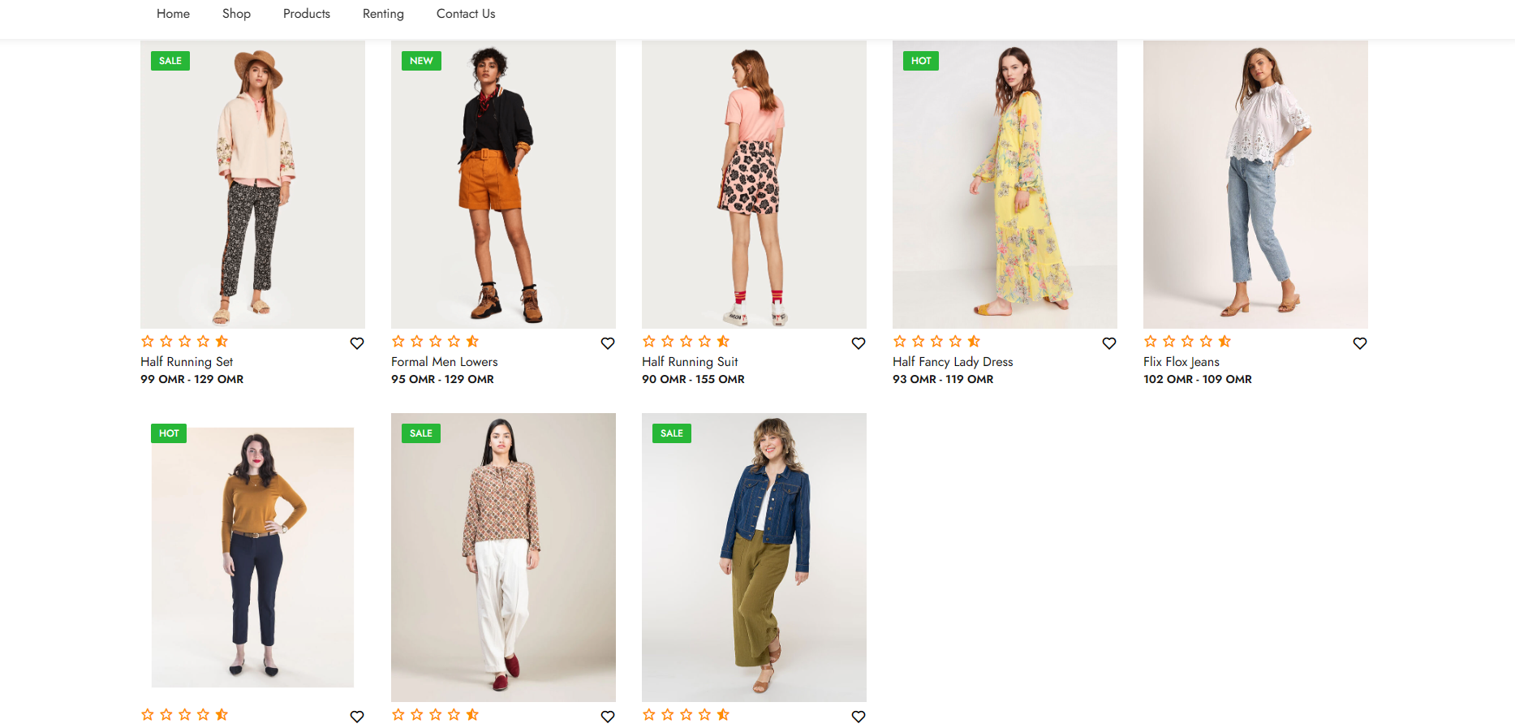
SCOPE OF THE PROJECT
Notes:
M: Core Functionalities:
Product Catalog: The website will feature a comprehensive product catalog with detailed descriptions, high-quality images, and user reviews. This will be the foundation for the e-commerce platform.
M: Personalized Search and Recommendations: A machine learning-powered recommendation engine will analyze user behavior to suggest relevant products based on browsing history, purchase data, and demographics. Dynamic search results will refine further based on user queries and past search patterns.
M: Shopping Cart and Checkout: A user-friendly shopping cart allows customers to add and remove items, review their purchases, and proceed to a secure checkout process.

Slide 5

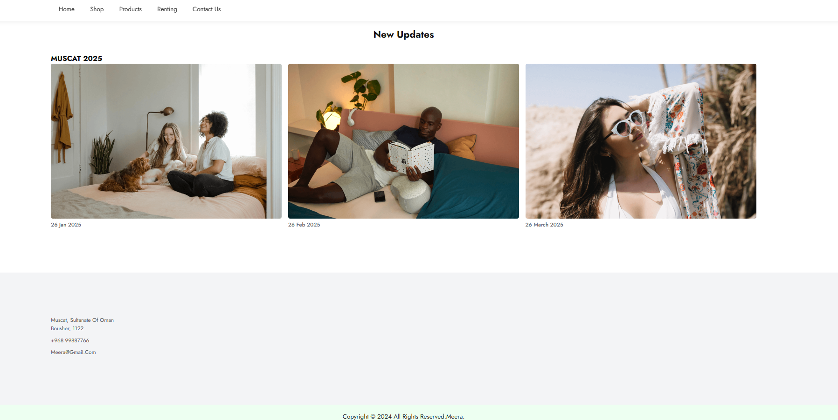
SYSTEM ANALYSIS AND DESIGN
CHIC
Notes:
B: In the process of designing and developing an e-commerce website for our final project as an IT graduate, I undertook a comprehensive system analysis and design approach to ensure the successful implementation of the project.
B: The system analysis phase began with a thorough examination of user requirements and business objectives. Through surveys, interviews, and stakeholder meetings, I gathered valuable insights into the target audience, desired features, and functional requirements of the e-commerce website.
B This analysis helped us gain a deeper understanding of user expectations, emerging trends, and technological advancements in the e-commerce domain.

Slide 6
SYSTEM DESIGN
CHIC
Notes:
M: Based on the findings from the system analysis phase, I proceeded to design the system architecture and user interface for the e-commerce website. This involved creating wireframes, mockups, and prototypes to visualize the layout, navigation flow, and interaction patterns of the website.
M: In designing the system architecture, I employed a modular and scalable approach, leveraging technologies such as HTML, CSS, JavaScript, and server-side scripting languages like PHP or Python. I also integrated third-party APIs for functionalities such as payment processing, shipping, and inventory management, ensuring seamless integration with external systems and services.

Slide 7
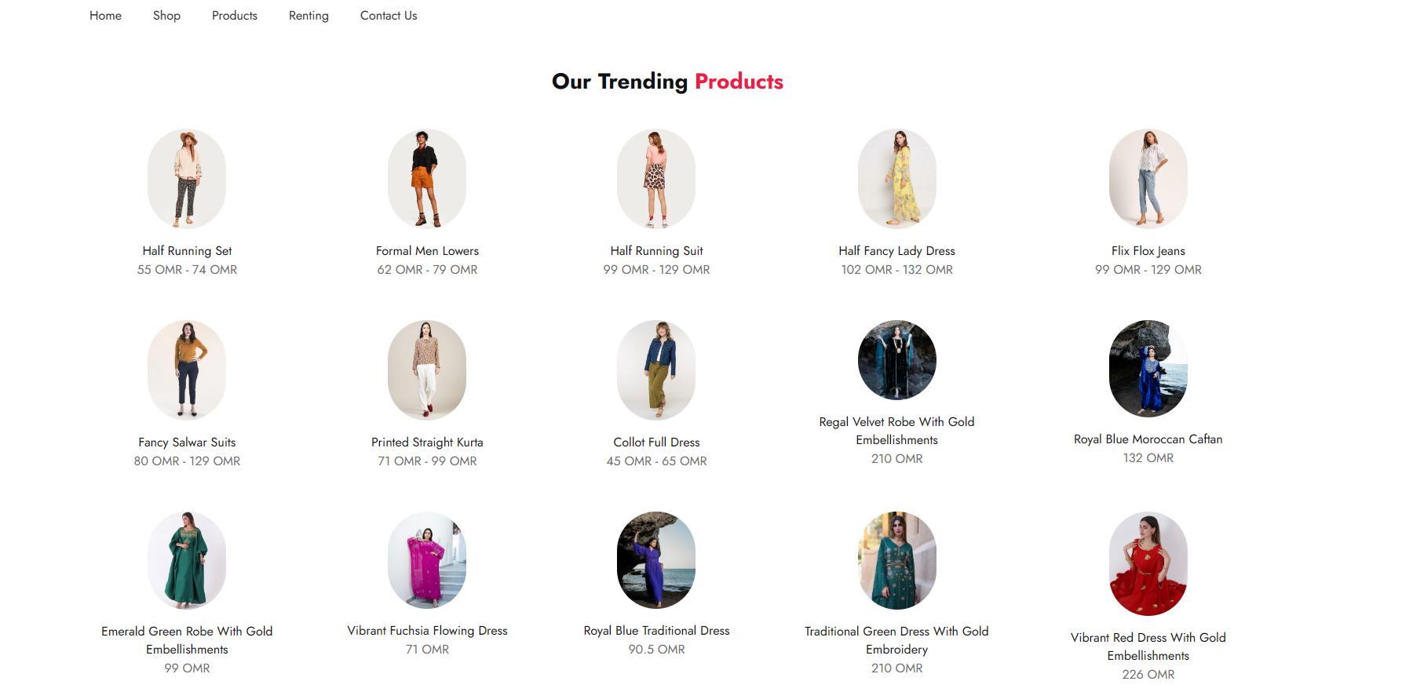
USER INTERFACE DESIGN

Slide 8

CHIC

Slide 9
CODES
<div class="update-cart">
<div class="cart">
<img src="image/bl-1.png" alt="">
<h5>26 jan 2025</h5>
</div>
<div class="cart">
<img src="image/bl-2.png" alt="">
<h5>26 Feb 2025</h5>
</div>
<div class="cart">
<img src="image/bl-3.png" alt="">
<h5>26 March 2025</h5>
</div>
</div>

Slide 10




Slide 11
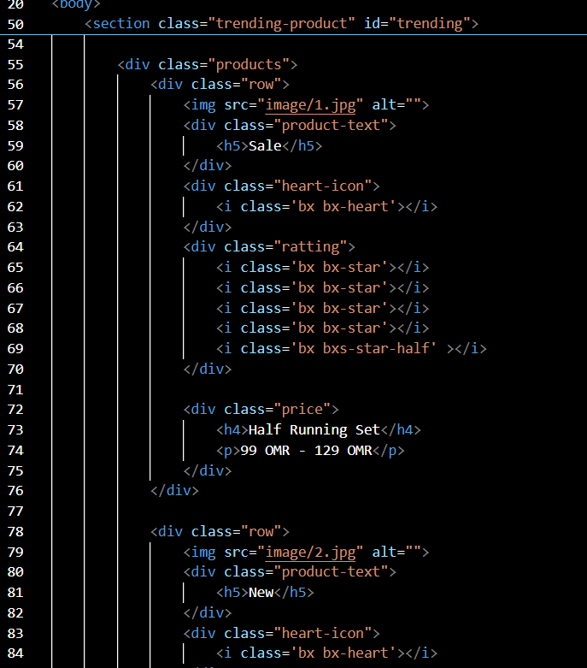
CODES

Slide 12

CONCLUSION
CHIC
WWW.CHIC.COM
Notes:
Thank you for listening to our presentation, if you have any questions please you may ask us. Thank you have a good day.

Slide 13
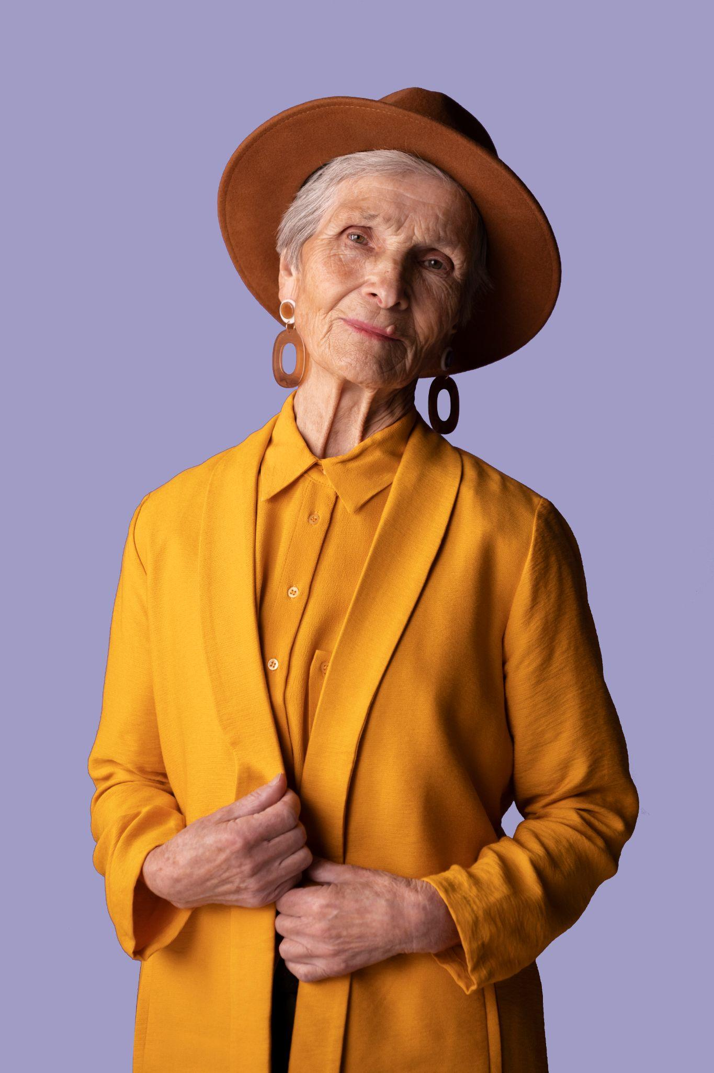
Meera Al Zadjali 20202701
Buthaina Almawali 20201971

